Slide 1

NED: An Inter-Graph Node Metric Based On Edit Distance
Haohan Zhu (Facebook, Inc)
Xianrui Meng (Apple, Inc)
George Kollios (Boston University)

Slide 2
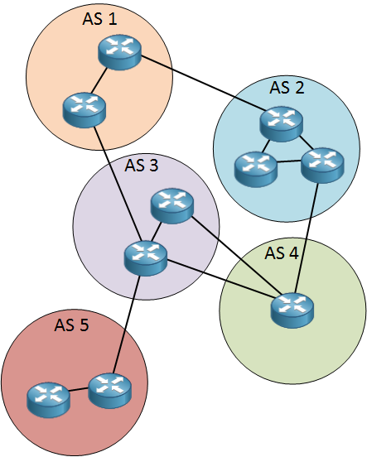
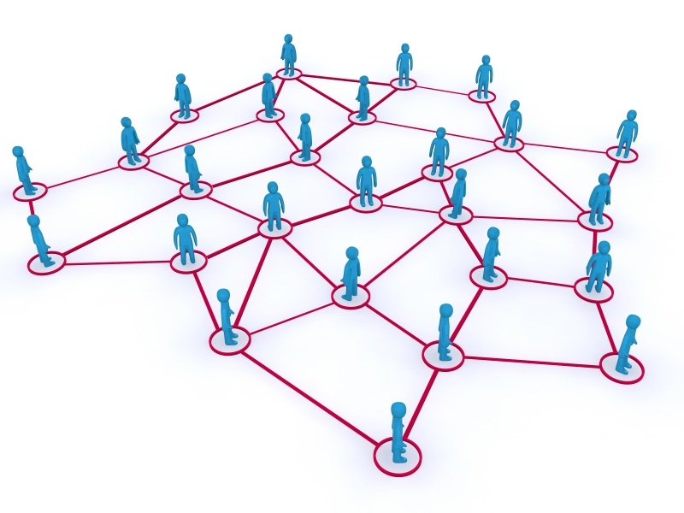
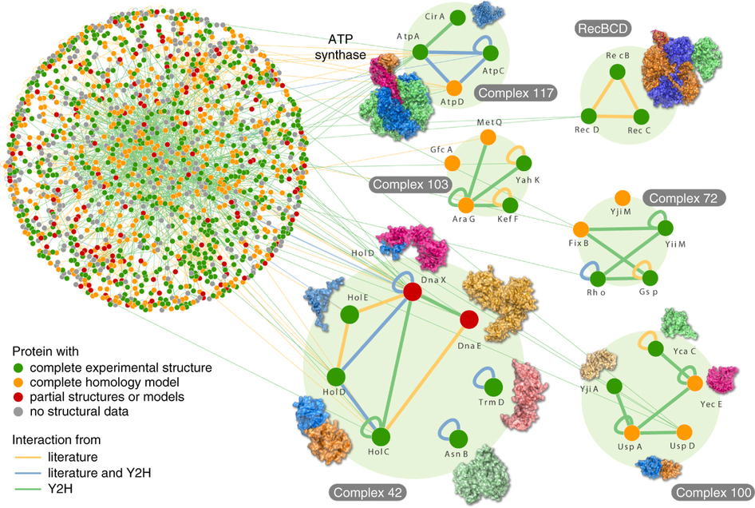
Node Similarity Applications
Transfer Learning
Communication Networks
Protein–Protein Interaction Networks (PPI)
Graph De-anonymization
Social Networks
Label-Free
Inter-Graph
Metric
From S. Rajagopala, et al., The binary protein-protein interaction landscape of Escherichia coli, Nature Biotechnology 32, 285–290 (2014)
From http://peeljet.blogspot.com
From https://networklessons.com

Slide 3
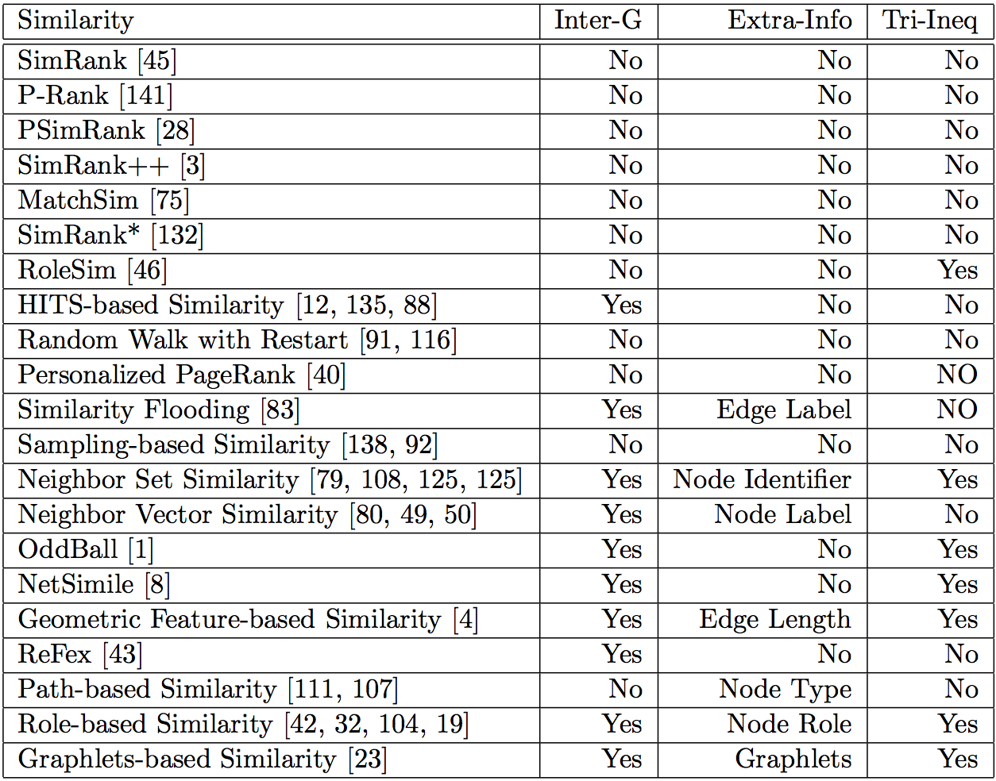
Existing Node Similarity Measures

Slide 4
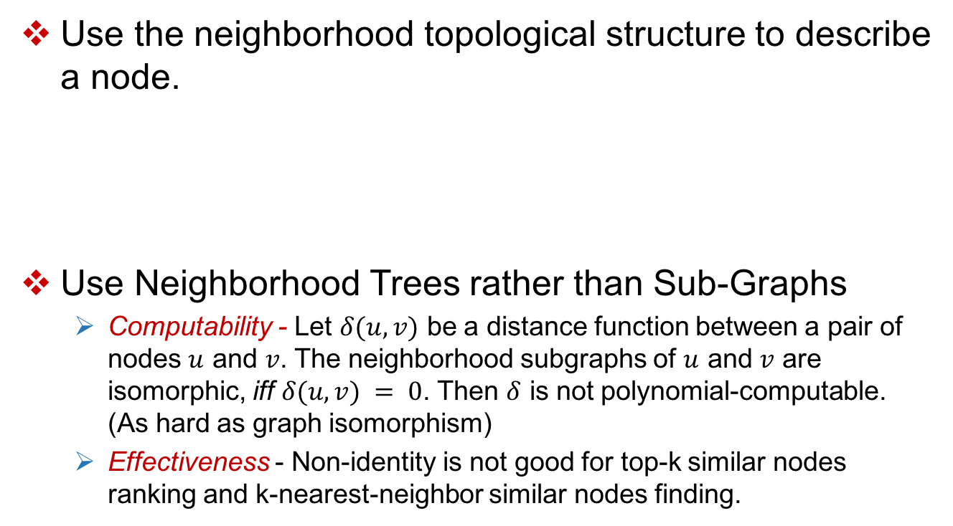
Node Similarity: NED
Use the neighborhood topological structure to describe a node.
Use Neighborhood Trees rather than Sub-Graphs
Computability - Let $δ(u, v)$ be a distance function between a pair of nodes $u$ and $v$. The neighborhood subgraphs of $u$ and $v$ are isomorphic, iff $δ(u, v) = 0$. Then $δ$ is not polynomial-computable. (As hard as graph isomorphism)
Effectiveness - Non-identity is not good for top-k similar nodes ranking and k-nearest-neighbor similar nodes finding.

Slide 5
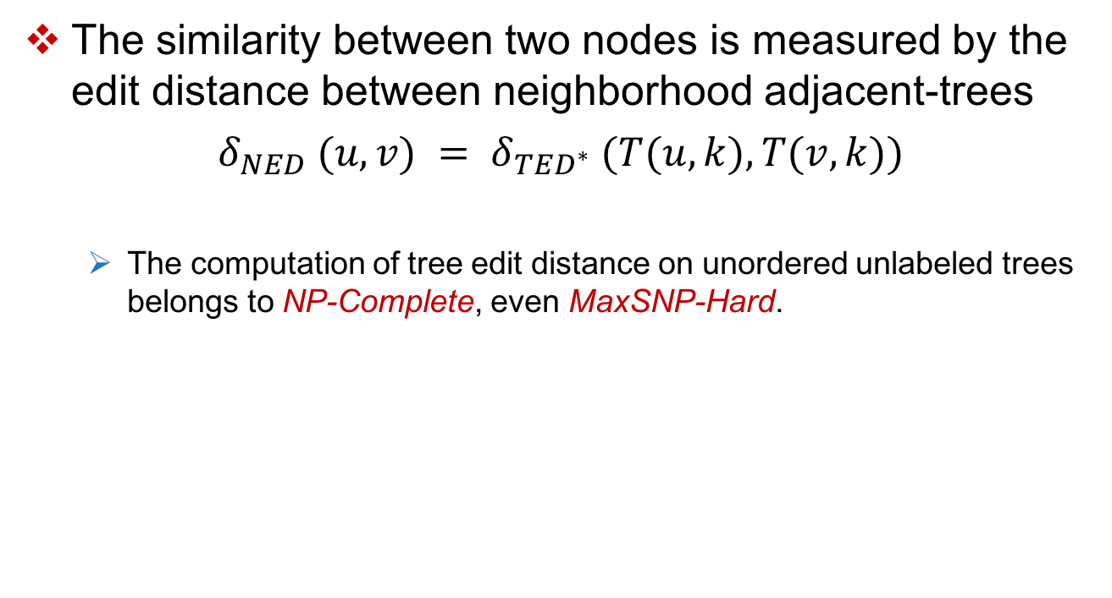
Tree Edit Distance
The similarity between two nodes is measured by the edit distance between neighborhood adjacent-trees
$δ_{NED} (u,v) = δ_{{TED}^{∗}} (T(u,k),T(v,k))$
The computation of tree edit distance on unordered unlabeled trees belongs to NP-Complete, even MaxSNP-Hard.

Slide 6
Modified Tree Edit Distance: TED*
Modified Tree Edit Distance:
No operation can change the depth of any existing node in the tree
Edit Operation in TED* :
Insert a leaf node
Delete a leaf node
Move a node at the same level
Advantage of TED* ?
Metric: The same as TED
Efficient: Polynomial time computable

Slide 7
Computation of TED*
A
𝛼
B
C
𝛽
𝛾
D
E
F
𝛿
𝜀
𝜁
G
H
I
J
K
L
𝜂
𝜃
𝜄
𝜅
𝜆
Iterative Bottom-Up Algorithm

Slide 8
Computation of TED*
A
𝛼
B
C
𝛽
𝛾
D
E
F
𝛿
𝜀
𝜁
G
H
I
J
K
L
Level 3
𝜂
𝜃
𝜄
𝜅
𝜆
𝜇
Padding
Padding Cost @ Lv 3 = 1

Slide 9
Computation of TED*
A
𝛼
B
C
𝛽
𝛾
D
E
F
𝛿
𝜀
𝜁
0
0
0
0
0
Level 3
0
0
0
0
0
0
G
H
I
J
K
L
𝜂
𝜃
𝜄
𝜅
𝜆
𝜇
0
Canonization

Slide 10
Computation of TED*
A
𝛼
B
C
𝛽
𝛾
D
E
F
𝛿
𝜀
𝜁
0
0
0
0
0
Level 3
0
0
0
0
0
0
G
H
I
J
K
L
𝜂
𝜃
𝜄
𝜅
𝜆
𝜇
0
Bipartite Graph Construction

Slide 11
Computation of TED*
A
𝛼
B
C
𝛽
𝛾
D
E
F
𝛿
𝜀
𝜁
0
0
0
0
0
Level 3
0
0
0
0
0
0
G
H
I
J
K
L
𝜂
𝜃
𝜄
𝜅
𝜆
𝜇
0
Bipartite Graph Matching
Matching Cost @ Lv 3 = 0

Slide 12
Computation of TED*
A
𝛼
B
C
𝛽
𝛾
D
E
F
𝛿
𝜀
𝜁
0
0
0
0
0
Level 3
0
0
0
0
0
0
G
H
I
J
K
L
𝜂
𝜃
𝜄
𝜅
𝜆
𝜇
0
Re-Canonization

Slide 13
Computation of TED*
A
𝛼
B
C
𝛽
𝛾
D
E
F
Level 2
𝛿
𝜀
𝜁
0
0
0
0
0
0
0
0
0
0
0
G
H
I
J
K
L
𝜂
𝜃
𝜄
𝜅
𝜆
𝜇
0
Padding
Padding Cost @ Lv 2 = 0

Slide 14
Computation of TED*
A
𝛼
B
C
𝛽
𝛾
D
E
F
Level 2
𝛿
1
3
2
𝜀
𝜁
2
1
2
0
0
0
0
0
0
0
0
0
0
0
G
H
I
J
K
L
𝜂
𝜃
𝜄
𝜅
𝜆
𝜇
0
Canonization

Slide 15
Computation of TED*
A
𝛼
B
C
𝛽
𝛾
D
E
F
Level 2
𝛿
1
3
2
𝜀
𝜁
2
1
2
0
0
0
0
0
0
0
0
0
0
0
G
H
I
J
K
L
𝜂
𝜃
𝜄
𝜅
𝜆
𝜇
0
Bipartite Graph Construction
0
D
𝛿
1
1
0
E
1
𝜀
1
1
F
2
𝜁
0

Slide 16
Computation of TED*
A
𝛼
B
C
𝛽
𝛾
D
E
F
Level 2
𝛿
1
3
2
𝜀
𝜁
2
1
2
0
0
0
0
0
0
0
0
0
0
0
G
H
I
J
K
L
𝜂
𝜃
𝜄
𝜅
𝜆
𝜇
0
Bipartite Graph Matching
0
D
𝛿
Matching Cost @ Lv 2 = 0
1
1
0
E
1
𝜀
1
1
F
2
𝜁
0

Slide 17
Computation of TED*
A
𝛼
B
C
𝛽
𝛾
D
E
F
Level 2
𝛿
1
2
3
3
𝜀
𝜁
2
1
2
0
0
0
0
0
0
0
0
0
0
0
G
H
I
J
K
L
𝜂
𝜃
𝜄
𝜅
𝜆
𝜇
0
Re-Canonization

Slide 18
Computation of TED*
A
𝛼
B
C
Level 1
𝛽
𝛾
D
E
F
𝛿
1
3
2
𝜀
𝜁
2
1
3
0
0
0
0
0
0
0
0
0
0
0
G
H
I
J
K
L
𝜂
𝜃
𝜄
𝜅
𝜆
𝜇
0
Padding
Padding Cost @ Lv 1 = 0

Slide 19
Computation of TED*
A
𝛼
5
6
Level 1
B
C
𝛽
𝛾
7
4
D
E
F
𝛿
1
3
2
𝜀
𝜁
2
1
3
0
0
0
0
0
0
0
0
0
0
0
G
H
I
J
K
L
𝜂
𝜃
𝜄
𝜅
𝜆
𝜇
0
Canonization

Slide 20
Computation of TED*
A
𝛼
5
6
Level 1
B
C
𝛽
𝛾
7
4
D
E
F
𝛿
1
3
2
𝜀
𝜁
2
1
3
0
0
0
0
0
0
0
0
0
0
0
G
H
I
J
K
L
𝜂
𝜃
𝜄
𝜅
𝜆
𝜇
0
Bipartite Graph Construction
B
1
𝛽
2
2
C
𝛾
1

Slide 21
Computation of TED*
A
𝛼
5
6
Level 1
B
C
𝛽
𝛾
7
4
D
E
F
𝛿
1
3
2
𝜀
𝜁
2
1
3
0
0
0
0
0
0
0
0
0
0
0
G
H
I
J
K
L
𝜂
𝜃
𝜄
𝜅
𝜆
𝜇
0
Bipartite Graph Matching
B
𝛽
Matching Cost @ Lv 1 = 1
1
2
2
C
𝛾
1

Slide 22
Computation of TED*
A
𝛼
6
Level 1
5
4
B
C
𝛽
𝛾
7
7
4
D
E
F
𝛿
1
3
2
𝜀
𝜁
2
1
3
0
0
0
0
0
0
0
0
0
0
0
G
H
I
J
K
L
𝜂
𝜃
𝜄
𝜅
𝜆
𝜇
0
Re-Canonization

Slide 23
Computation of TED*
A
Level 0
𝛼
7
4
B
C
𝛽
𝛾
7
4
D
E
F
𝛿
1
3
2
𝜀
𝜁
2
1
3
0
0
0
0
0
0
0
0
0
0
G
H
I
J
K
L
𝜂
𝜃
𝜅
𝜆
𝜇
0
𝜄
0
Padding
Padding Cost @ Lv 0 = 0

Slide 24
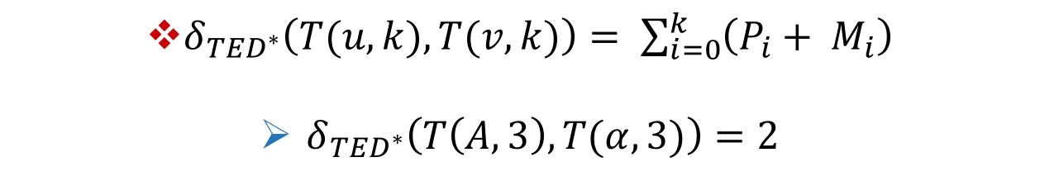
Computation of TED*
A
𝛼
B
C
𝛽
𝛾
D
E
F
𝛿
𝜀
𝜁
G
H
I
J
K
L
𝜂
𝜃
𝜄
𝜅
𝜆
$δ_{{TED}^{∗}}\left(T(u,k),T(v,k)\right)= \sum_{i=0}^{k}{\left(P_{i}+ M_{i}\right)}$
$δ_{{TED}^{∗}}\left(T\left(A,3\right), T(α, 3)\right)=2$

Slide 25
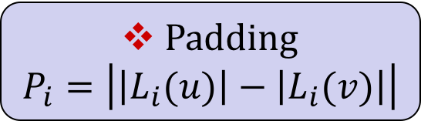
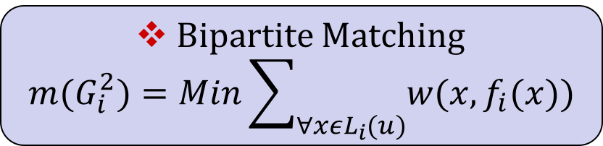
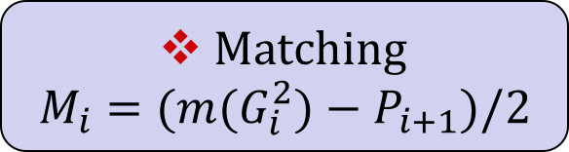
Computation of TED*
Canonization
Padding
$$P_{i}=\left|\left|L_{i}(u)\right|−\left|L_{i}(v)\right|\right|$$
Matching
$$M_{i}=(m(G_{i}^{2})−P_{i+1})/2$$
Bipartite Graph
Bipartite Matching
$$m(G_{i}^{2})=\operatorname{Min}{\sum_{∀xεL_{i}(u)}{w(x, f_{i}(x))}}$$

Slide 26
TED* vs TED & GED

Slide 27
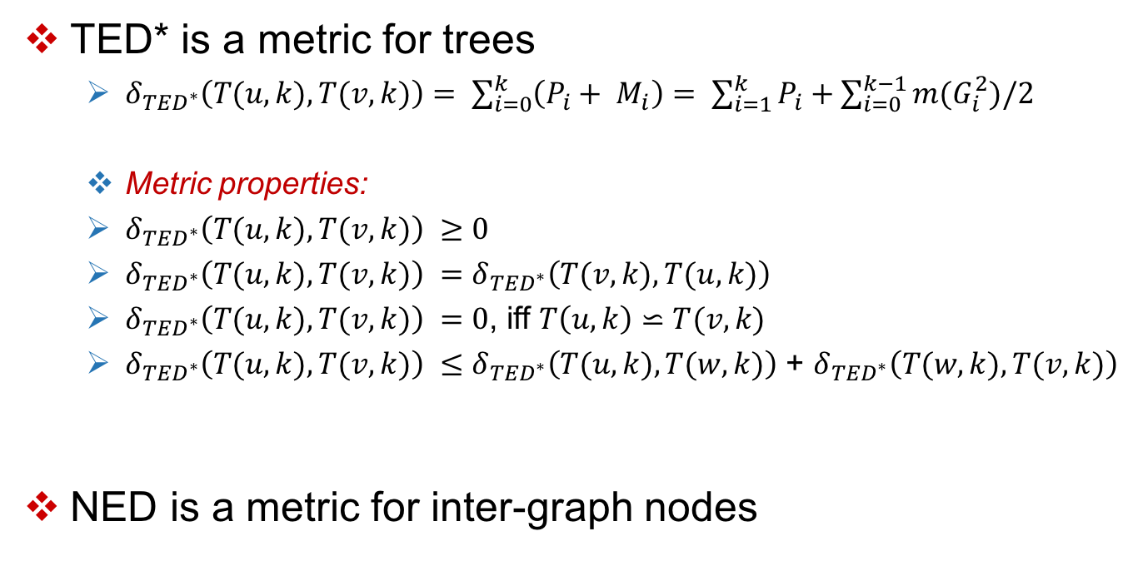
TED* is a metric, so is NED
TED* is a metric for trees
$δ_{{TED}^{∗}}\left(T(u,k),T(v,k)\right)= \sum_{i=0}^{k}{\left(P_{i}+ M_{i}\right)}$ $= \sum_{i=1}^{k}{P_{i}}+\sum_{i=0}^{k−1}{m(G_{i}^{2})/2}$
Metric properties:
$δ_{{TED}^{∗}}\left(T(u,k),T(v,k)\right) ≥0$
$δ_{{TED}^{∗}}\left(T(u,k),T(v,k)\right) =δ_{{TED}^{∗}}\left(T(v,k),T(u,k)\right)$
$δ_{{TED}^{∗}}\left(T(u,k),T(v,k)\right) =0$, iff $T\left(u,k\right)⋍T(v,k)$
$δ_{{TED}^{∗}}\left(T(u,k),T(v,k)\right) ≤δ_{{TED}^{∗}}\left(T(u,k),T(w,k)\right)$ + $δ_{{TED}^{∗}}\left(T(w,k),T(v,k)\right)$
NED is a metric for inter-graph nodes

Slide 28
TED* vs TED on Efficiency

Slide 29
NED Case Study: De-anonymization

Slide 30
Thank You !

